Slide 1
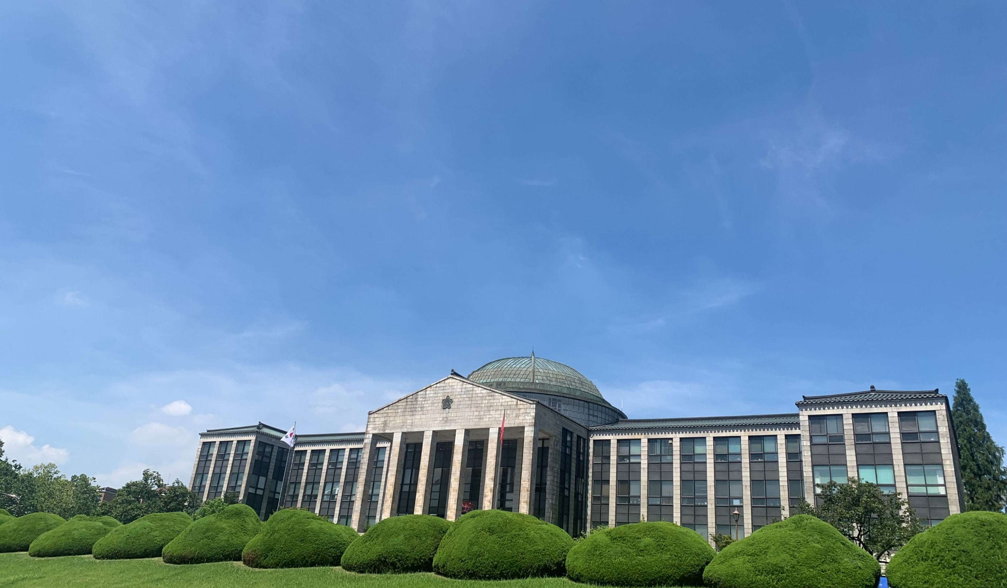
컴퓨팅사고와 SW코딩
안병준 coolbrise@knu.ac.kr

Slide 2
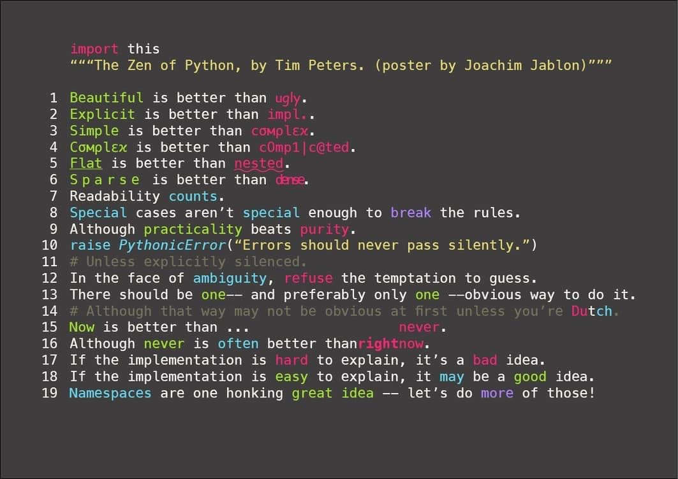

Slide 3
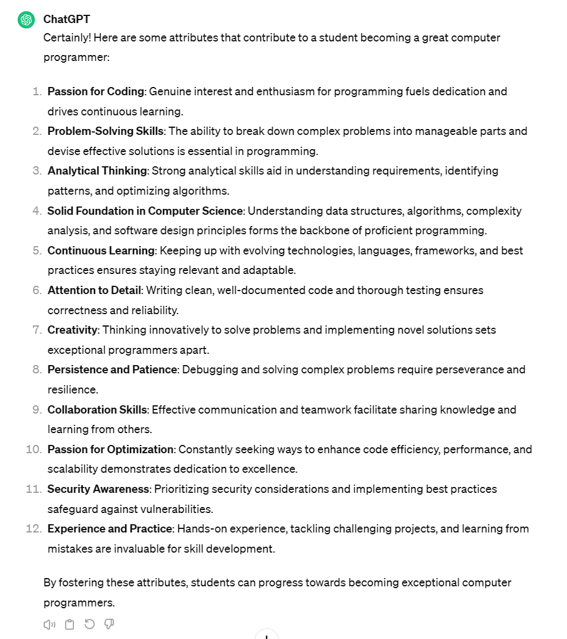

Slide 4
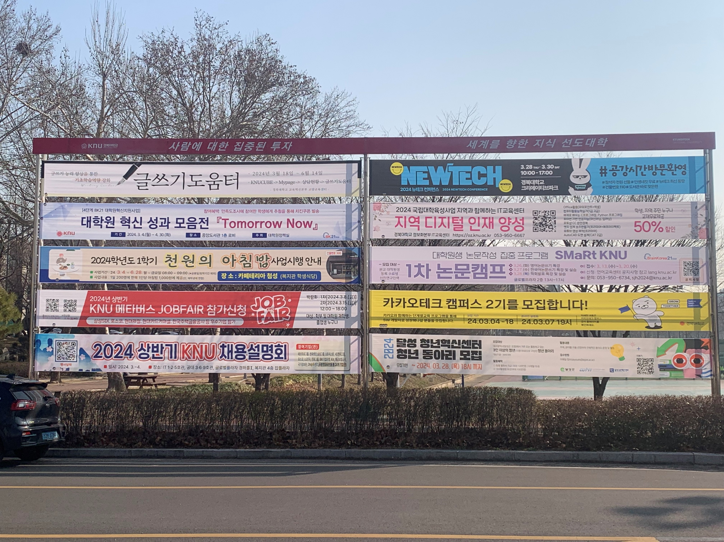

Slide 5
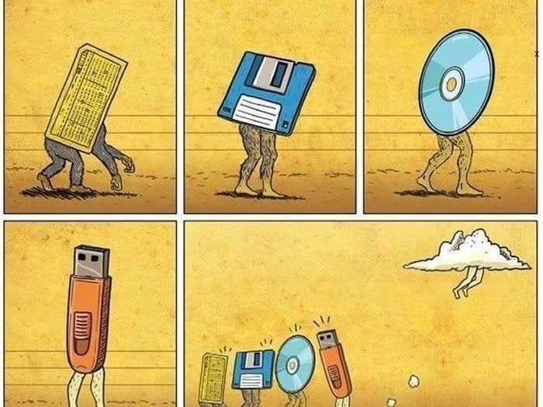

Slide 6
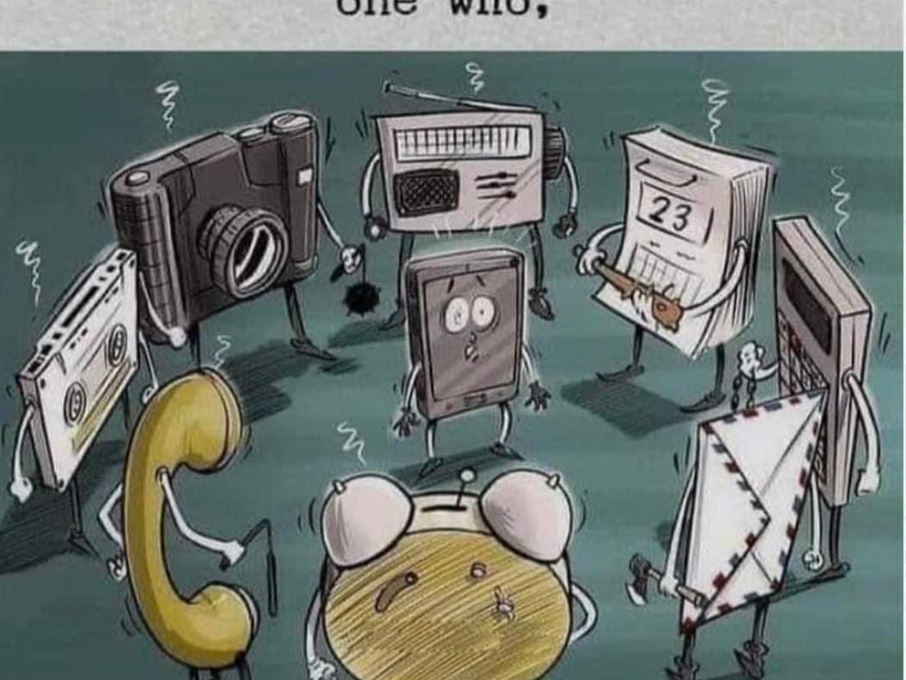
Who are you?

Slide 7
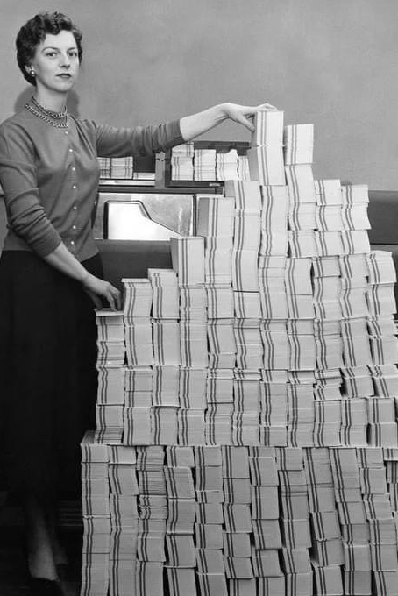
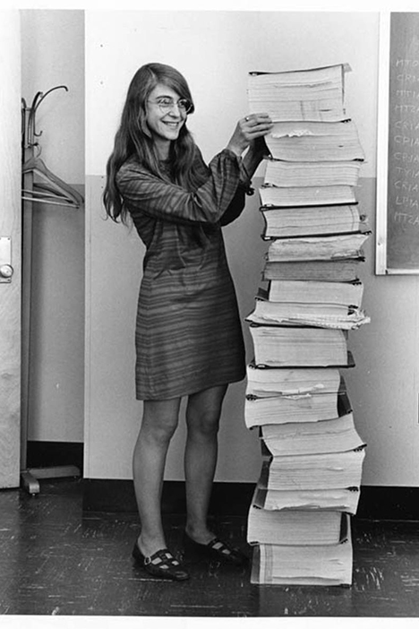

Slide 8
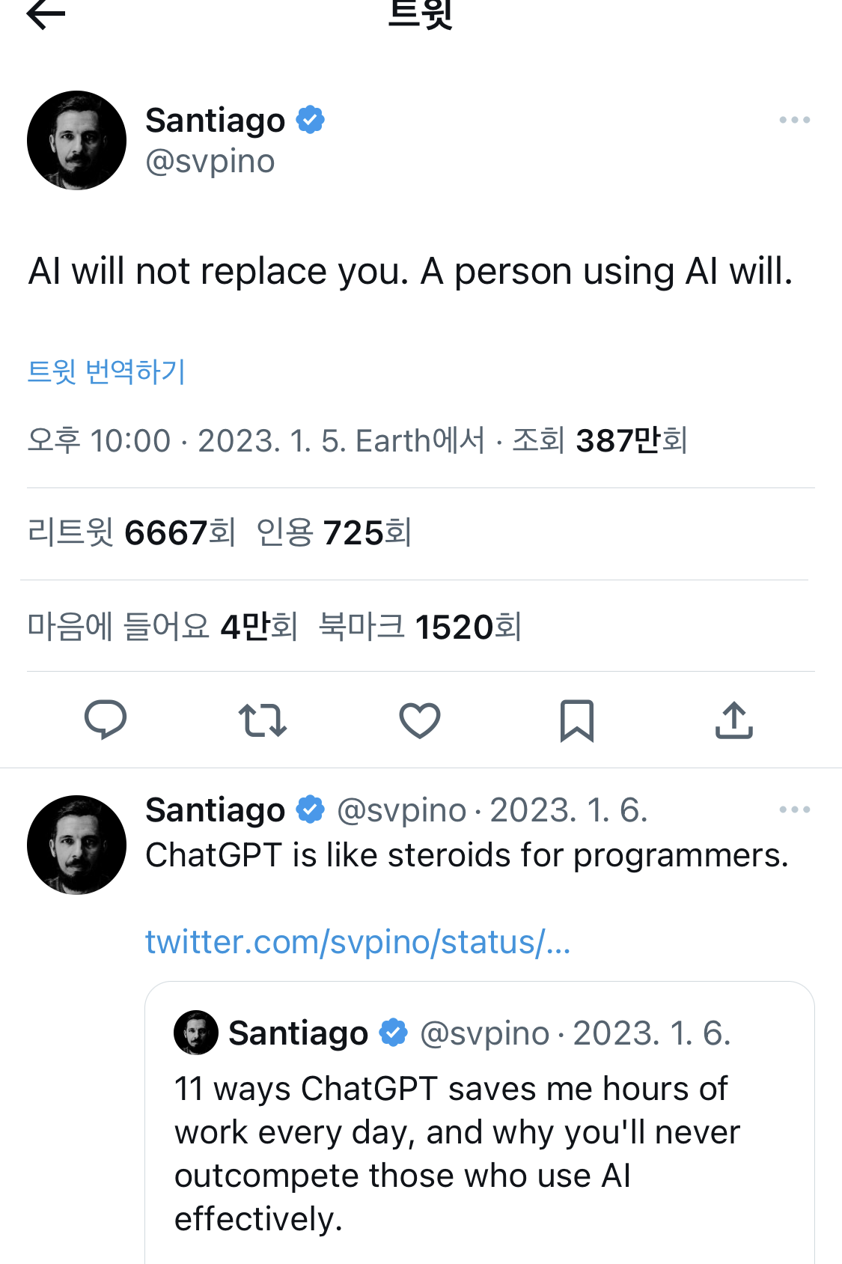

Slide 9
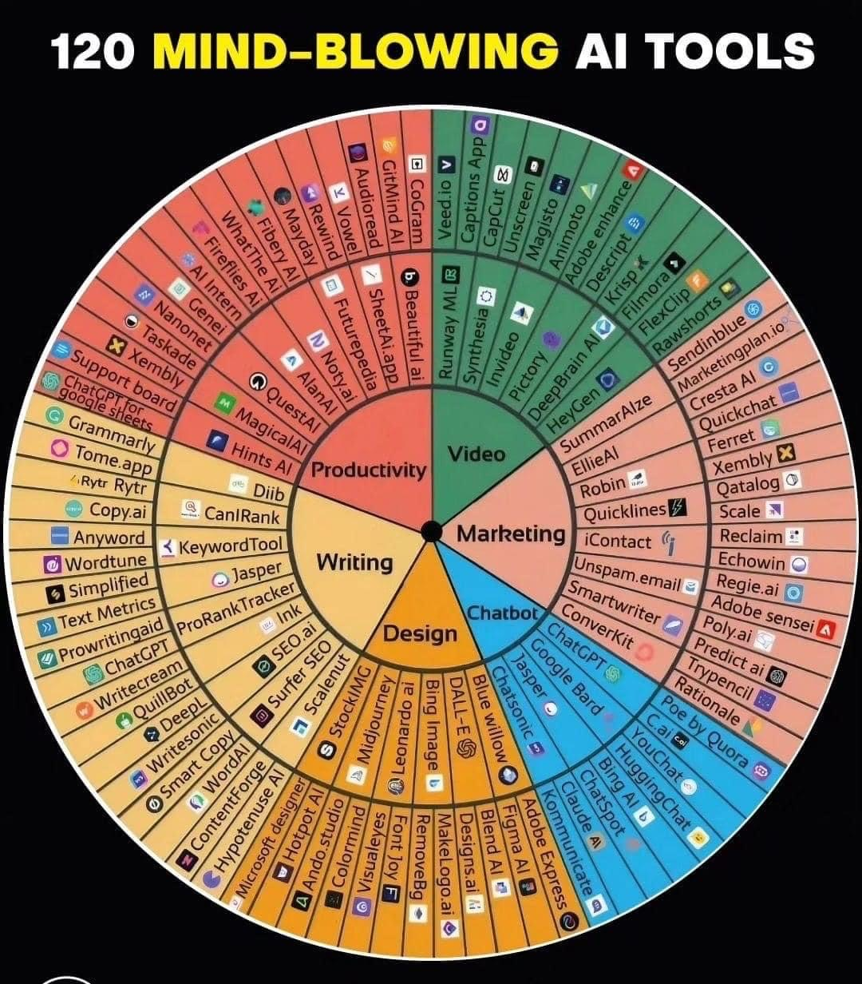

Slide 10
Further Studies
TED
https://youtu.be/SvBR0OGT5VI?si=poY4WZwXtm02jFGS
AI update
https://youtu.be/DqnTt1JtGXQ?si=-5vXn4rB22IL8ZAk
Watch a movie
https://www.imdb.com/title/tt4846340/

Slide 11
“Sometimes, it’s the very people who no one imagines anything of who do the things no one can imagine.”
– Imitation Game

